Slide 1
Specifying object implementation
Presented By:
Vaishali Patel & Jonty Beddoes
On: 31/05/2018

Slide 2
What is object implementation?
The implementation of objects must adhere to the principles of object-oriented methodology.
The object’s implementation is defined by its class. The class defines the object’s internal data and representation and defines the operations the object can perform.
Objects are created by instantiating a class, the object is said to be an instance of the class.

Slide 3
Objects provides a number of benefits:
Modularity: code can be maintained independently of other source code
Information-hiding: specific implementations are unknown from the outside world
Code reuse: code already implemented, tested, and case-specific may be used within another program
Pluggability and debugging ease: problems can be traced to specific instances of code and may be replaced with another object

Slide 4
When to use object implementation?
Software objects are conceptually similar to real-world objects: they too consist of state and related behaviour.
An object stores its state in fields (variables in some programming languages) and exposes its behaviour through methods (functions in some programming languages).
Methods operate on an object's internal state and serve as the primary mechanism for object-to-object communication.

Slide 5
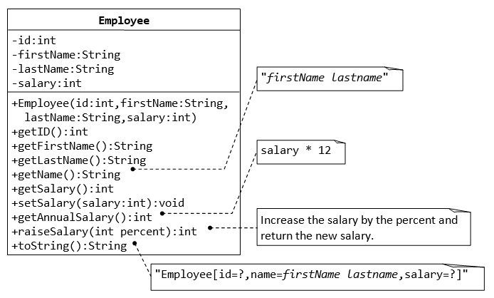
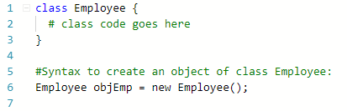
Object Representation

Slide 6
OOP has four basic concepts
Abstraction: is a process where you show only “relevant” data and “hide” unnecessary details of an object from the user.
Encapsulation: It provides only essential information to the outside world and hiding their background details.
Inheritance: The ability to create a new class from an existing class.
Polymorphism: Occurs when there is a hierarchy of classes and they are related by inheritance.

Slide 7
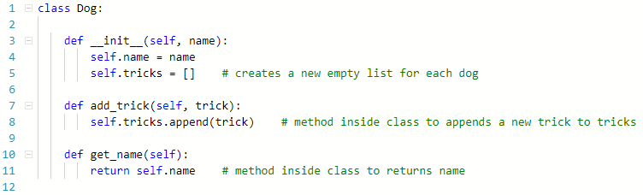
Python Code demo of object implementation

Slide 8
References:

Slide 9
THANK YOU

